Slide 1

PYTHON
Visualization

Slide 2
Table of Content
Visualization in Python
Matplotlib
Pyplot
Seaborn
Different plots in Matplotlib
Different plots in Seaborn
Summary

Slide 3
Python Visualization
Visual description of data.
Provides better understanding of data.
Python provides variety of libraries, e.g.: Matplotlib, Seaborn, ggplot, Plotly, etc.
Helps to explore patterns, trends, and correlations.
Helps to present reports, outcomes, and inferences in visual format.

Slide 4
Matplotlib
Python library for visualization
Build on NumPy arrays
“conda install -c conda-forge matplotlib”
Pyplot class supports wide variety of plots
Line plot
Polar plot
Scatter plot
Matplotlib
Pie chart
Bar plot
Histogram

Slide 5
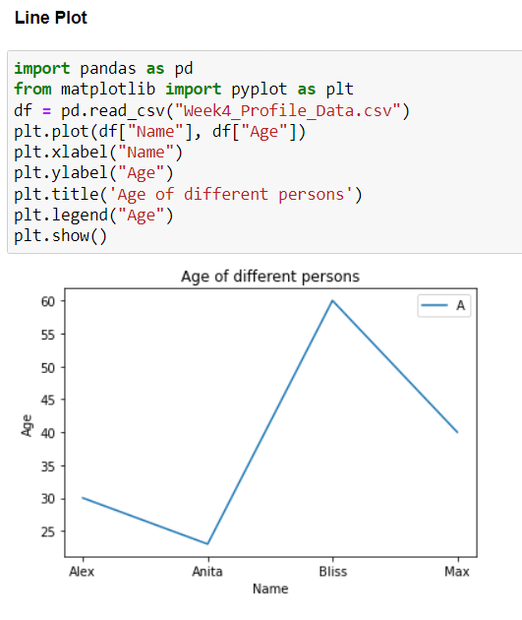
Pyplot
Matplotlib module that provides collection of functions for plotting
Gives MATLAB like interface to matplotlib

Slide 6
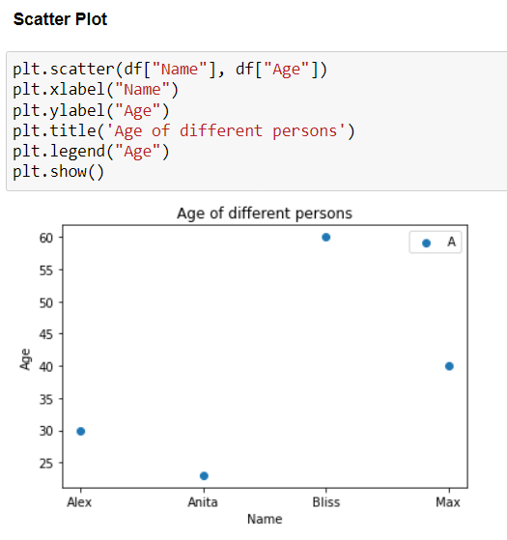
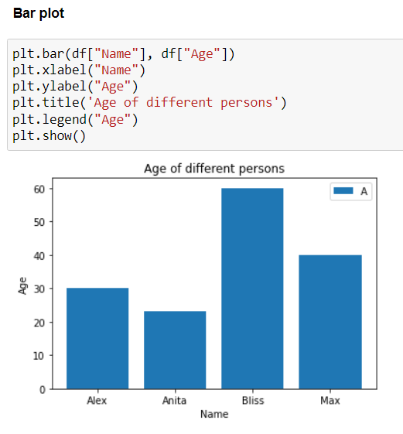
Different Plots In Matplotlib

Slide 7
Seaborn
Build on top of Matplotlib
Integrated with Pandas data structure
Command : conda install -c anaconda seaborn
Makes statistical plots more attractive
Distribution plot
Heat map
Pair plot
Seaborn
Bar plot
Swarm plot
Histplot()

Slide 8
Different Plots In Seaborn
Distribution plot for continuous data
displot()
histplot()
kdeplot()
Categorical plots for categorical data
barplot()
countplot()
boxplot()
violinplot()
swarmplot()
stripplot()
Relational plots for checking relationship between two or more variables
joinplot()
pairplot()
scatterplot()
relplot()
lineplot()
heatmap()

Slide 9
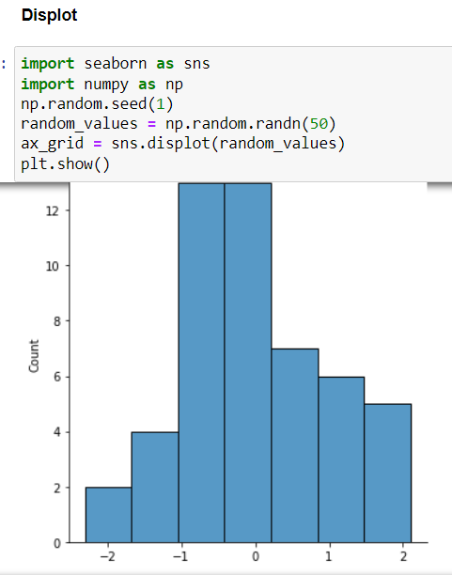
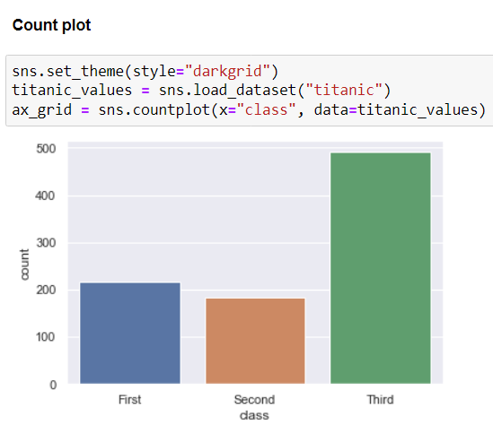
Different Plots In Seaborn

Slide 10
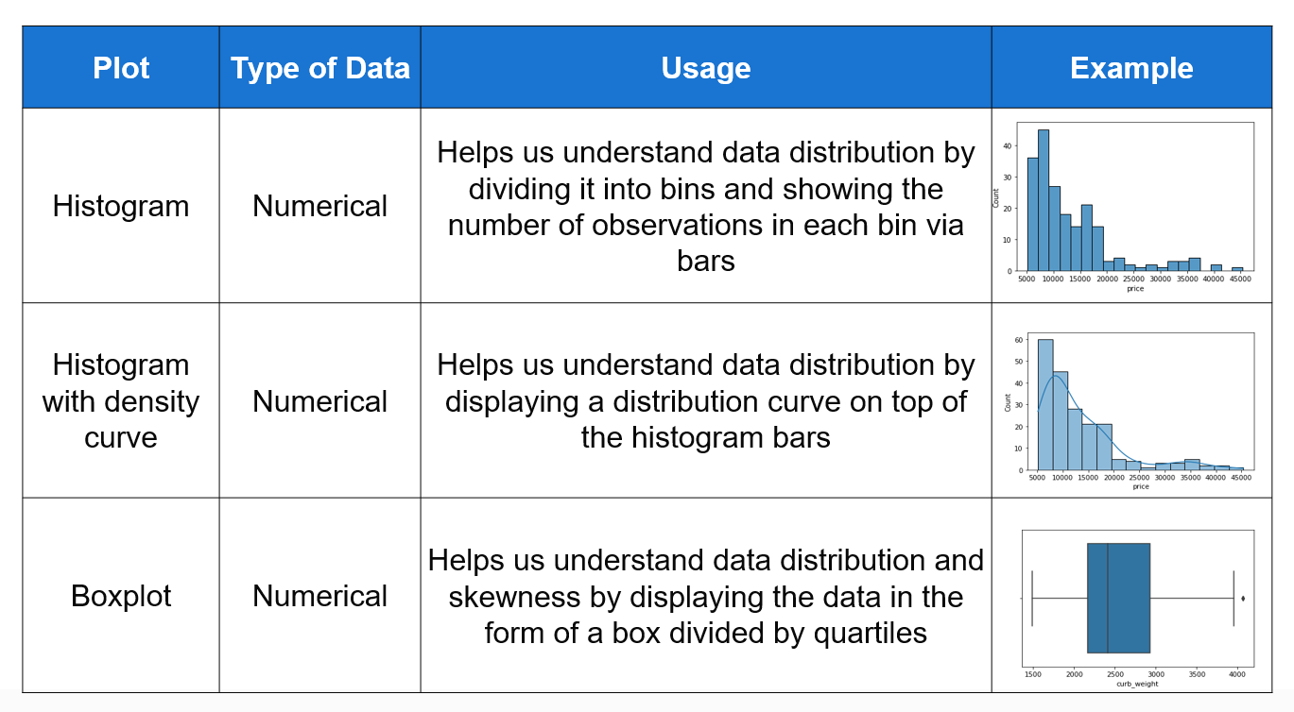
Visualization – One Variable

Slide 11
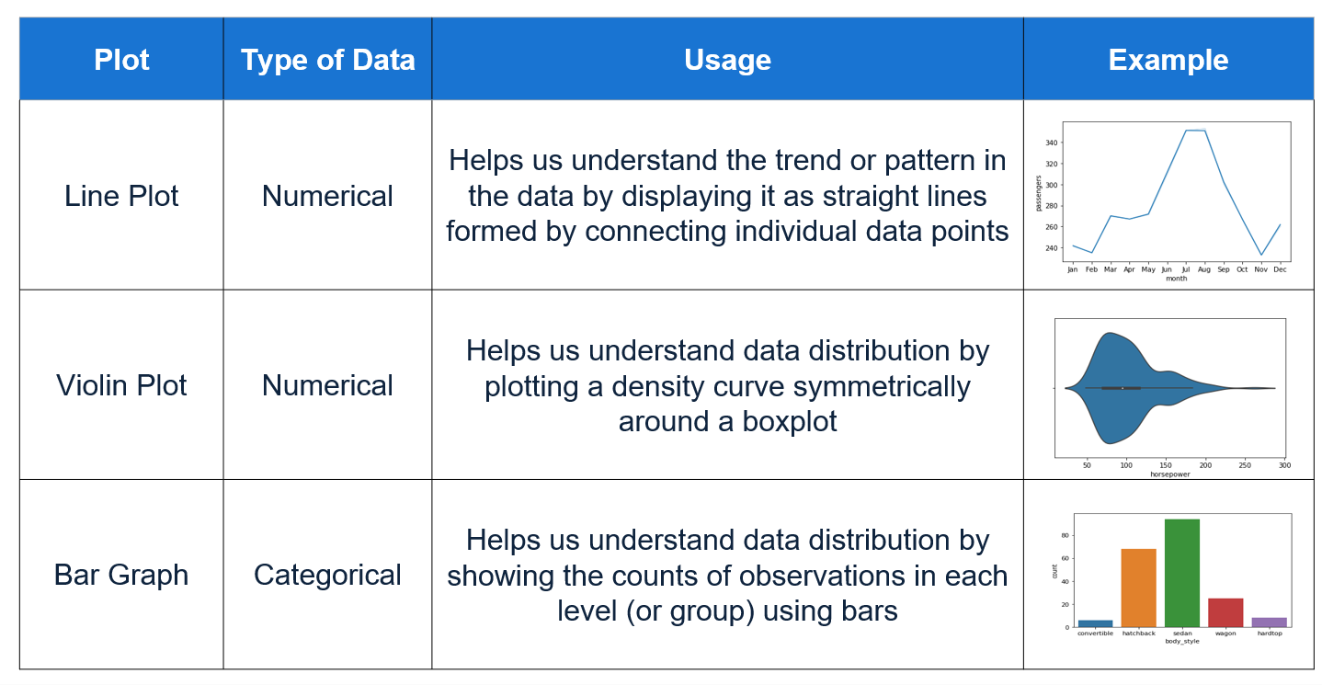
Visualization – One Variable

Slide 12
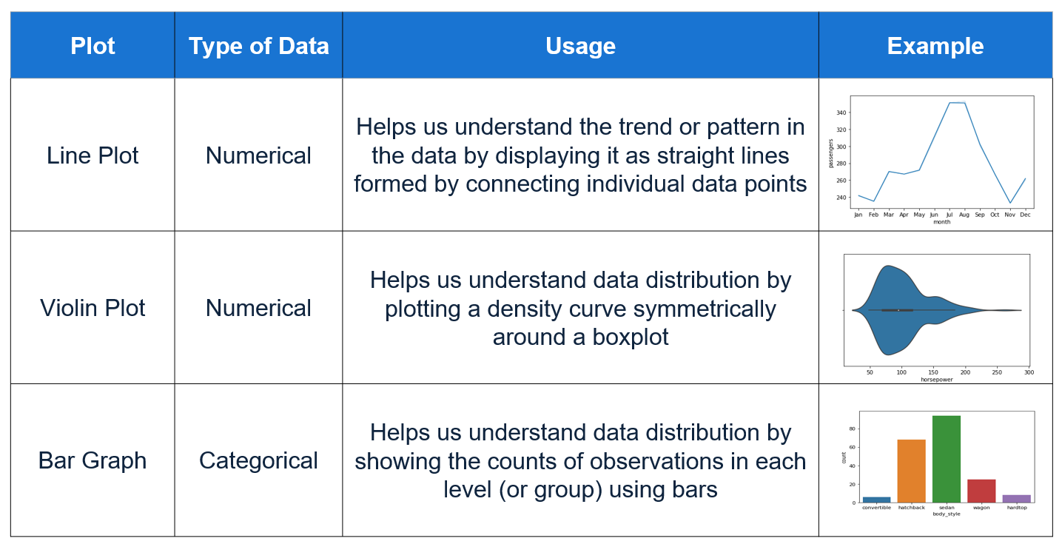
Visualization – Two Variable

Slide 13
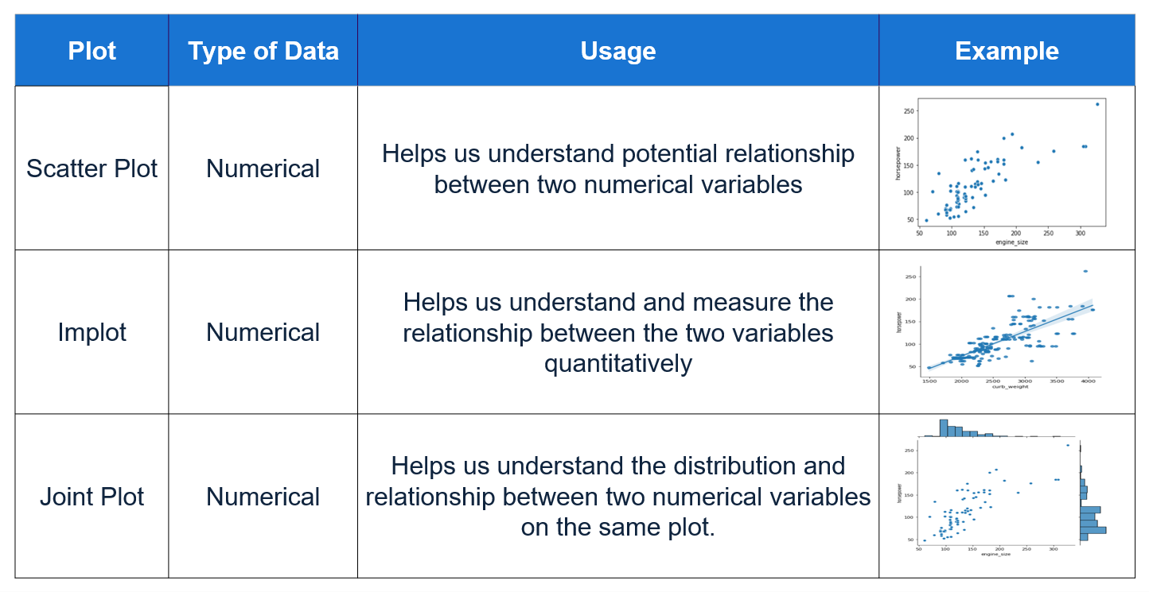
Visualization – Two Variable

Slide 14
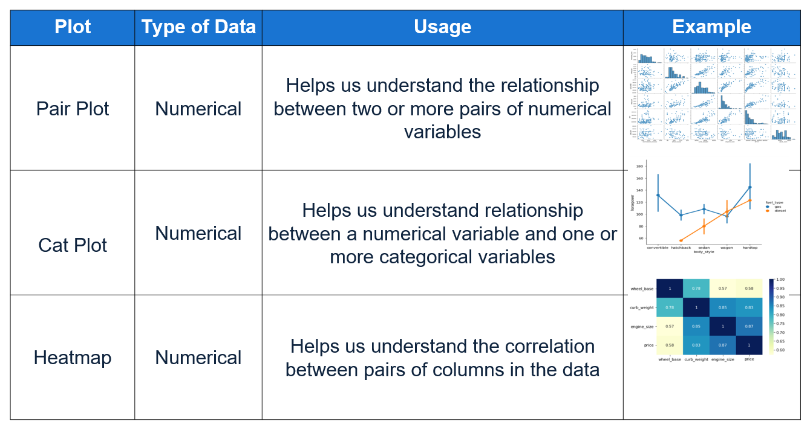
Visualization – Multiple Variable

Slide 15
Summary
Discussed visualization techniques in Python.
Matplotlib and use of Pyplot module.
Different plots associated with Matplotlib.
Seaborn in Python
Different plots associated with Seaborn.

Slide 16
Hands-On

Slide 17
THANK YOU Happy Learning ☺

